Slide 1

MIS 587
NYC
Vehicle Collisions Data Insights
Group 5
Archana Mahapatra
Kaumudi Kulkarni
Madhvika Sehgal

Slide 2
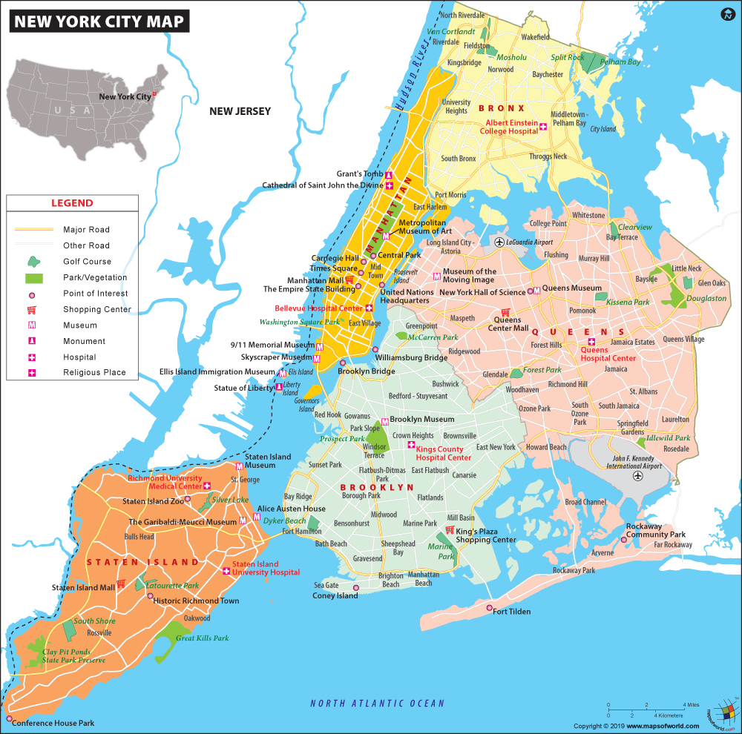
INTRODUCTION
28 CAR ACCIDENTS PER HOUR
1 CAR ACCIDENT EVERY 2 MINUTES
https://www.dandalaw.com/2019/06/05/are-car-accidents-common-in-new-york-city/

Slide 3
Find patterns involved which might cause vehicular collisions, hence reduce risk of collision
GOAL
Suggest recommendations to reduce city traffic fatalities

Slide 4
DATASET DETAILS
NYPD, NYC TRAFFIC DEPT, NYC DEPT. OF TRANSPORTATION
CLIENT
https://data.ny.gov/Public-Safety/Motor-Vehicle-Collisions-Crashes/h9gi-nx95
DATA SOURCE
> 1.1 MILLION RECORDS
NO OF ROWS
29
NO OF FEATURES

Slide 5
IMPORTANT ATTRIBUTES
CRASH DATE & TIME
BOROUGH, ZIP CODE
LATITUDE, LONGITUDE
NUMBER OF PEDESTRIANS, CYCLISTS, MOTORISTS INJURED/KILLED
CONTRIBUTING FACTORS
PRECIPITATION
SNOWFALL
ON STREET NAME
VEHICLE TYPE

Slide 6
Cleaned MISSING/NULL values for certain attributes like location, borough, latitude, longitude
Removed variables that had low variability
Data Preprocessing
Renamed and grouped variables, dimension reduction

Slide 7
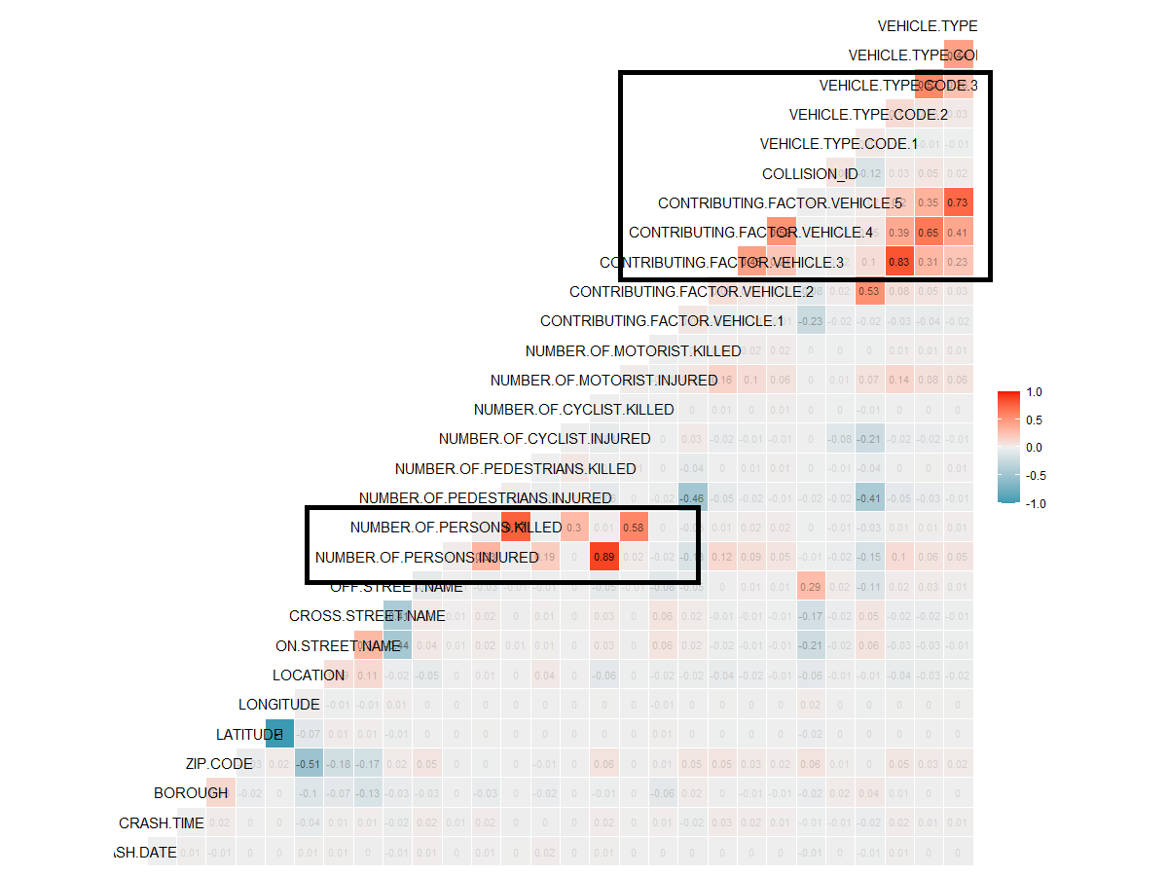
CORRELATION MATRIX
No major trends seen in correlation

Slide 8
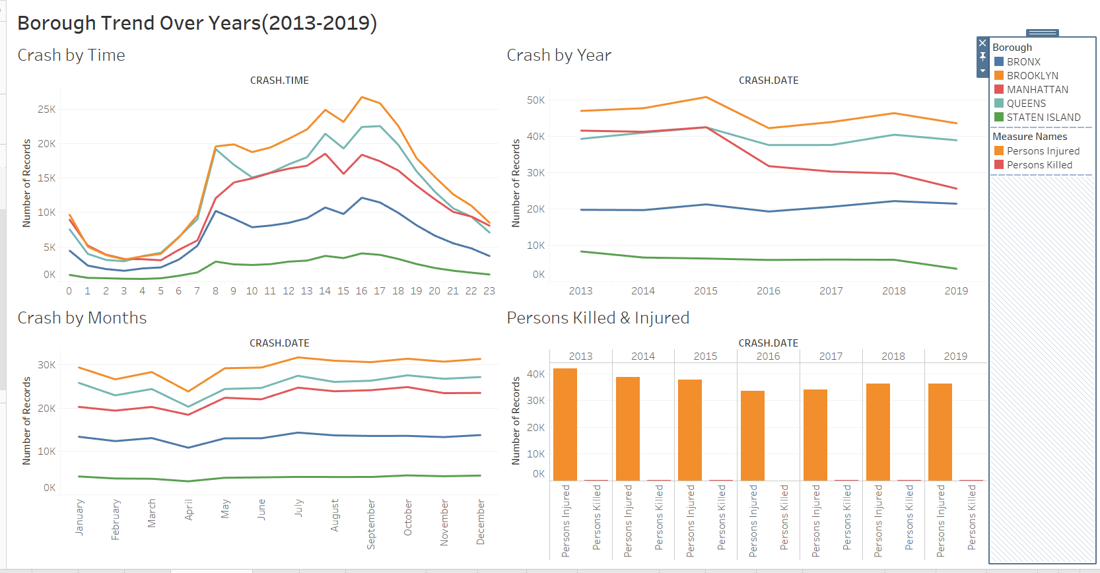
EXPLORATORY ANALYSIS
Notes:
Crash by months less in April coz in the start of spring NYPD increases police force on the streets.

Slide 9
DATA ANALYSIS:
R, Excel, Tableau
Solution
&
Tools used
DATA VISUALIZATION: Tableau

Slide 10
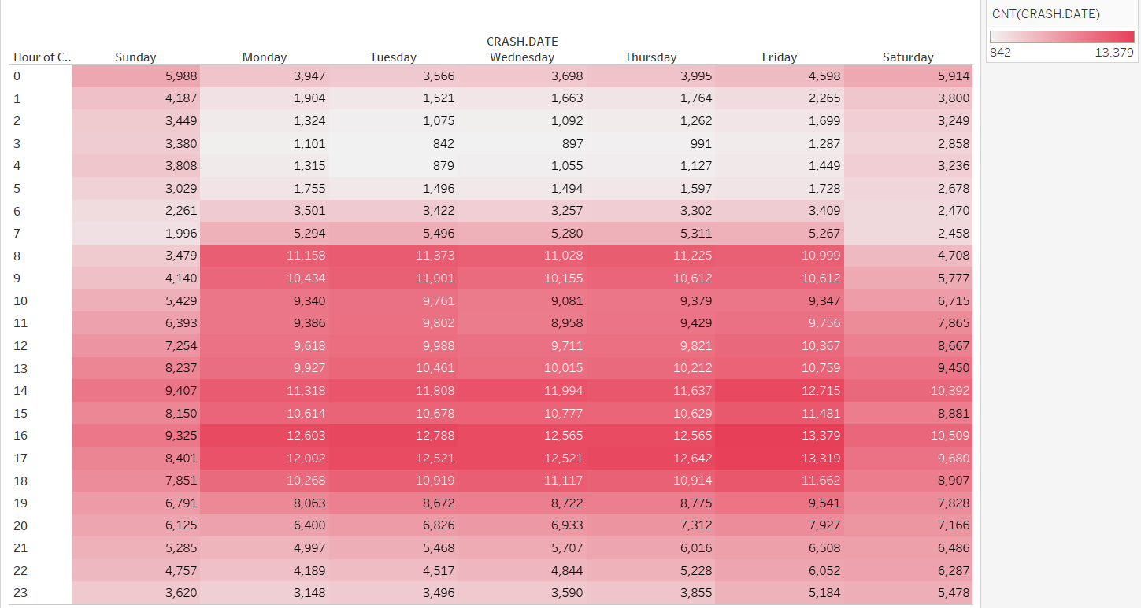
Collisions by day of the week
Collisions on weekdays more than collisions on weekends
Notes:
Analysis over 1 million data shows an constant trend in collision over the years in New York

Slide 11
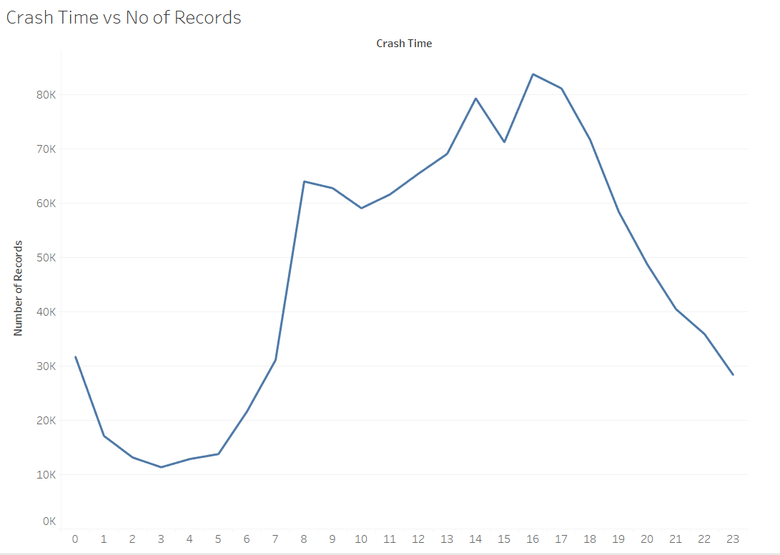
TIME OF COLLISIONS
Maximum Accidents taking place between 4pm-5pm
Notes:
Analysis over 1 million data shows an constant trend in collision over the years in New York

Slide 12
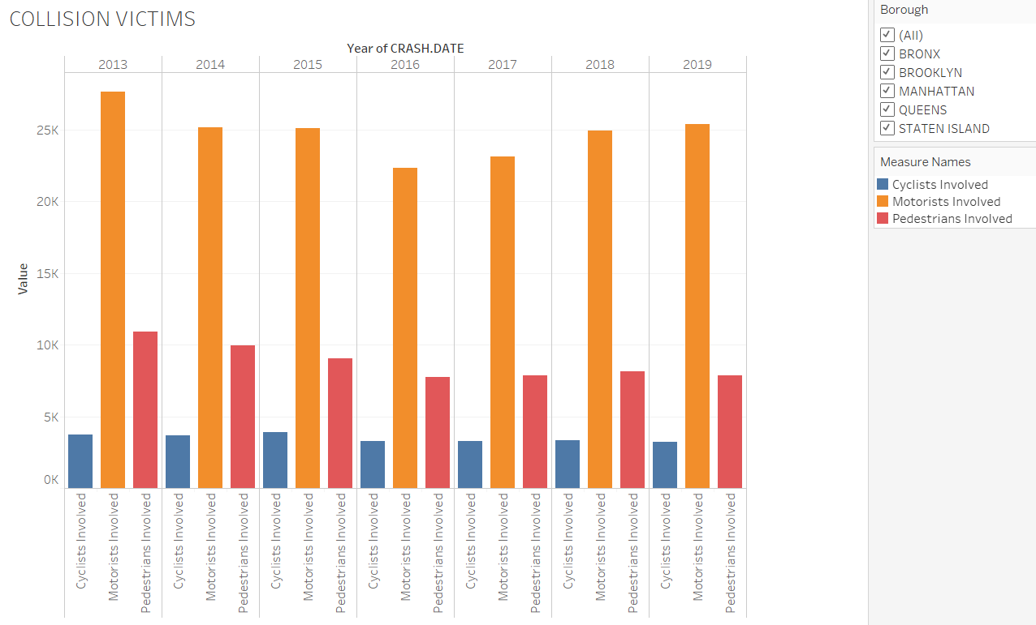
Vehicle collision victims
Notes:
Analysis over 1 million data shows an constant trend in collision over the years in New York

Slide 13
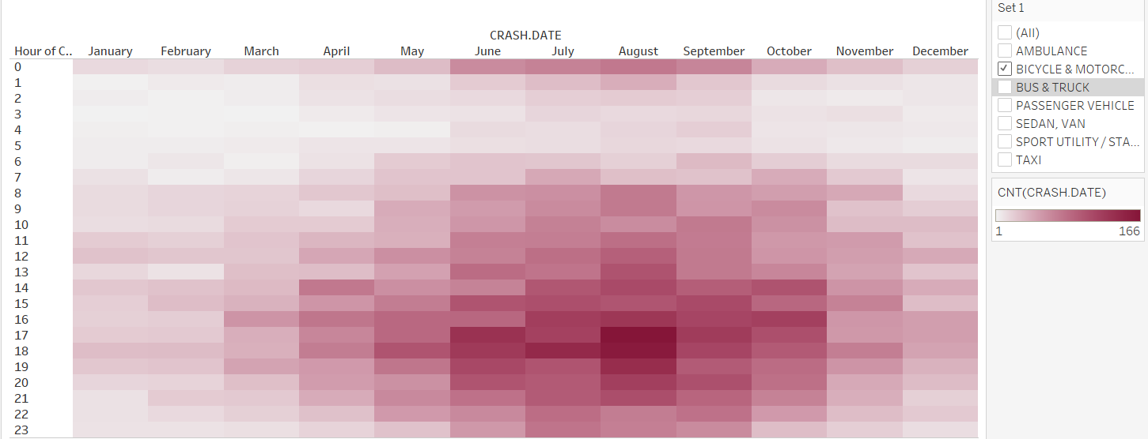
Two-wheeler Collisions

Slide 14
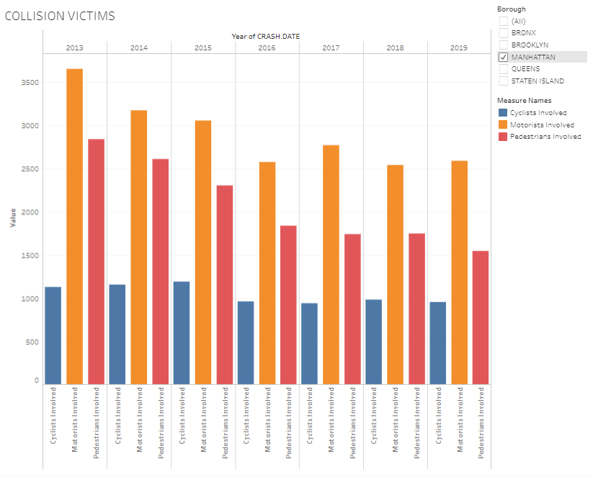
MANHATTAN PEDESTRIANS
Manhattan has higher pedestrians fatalities involved compared to the other boroughs
Notes:
The ratio of pedestrians are comparable to the motorists involved in Manhattan whereas the cases involving pedestrians in small

Slide 15
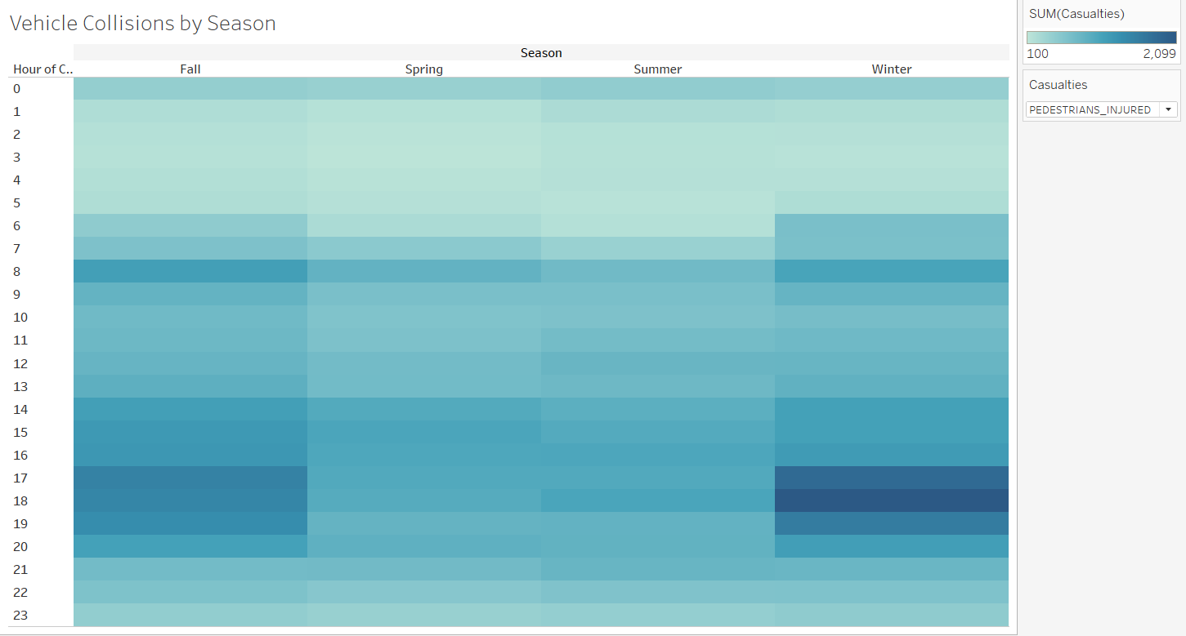
PEDESTRIANS INJURED BY SEASON

Slide 16
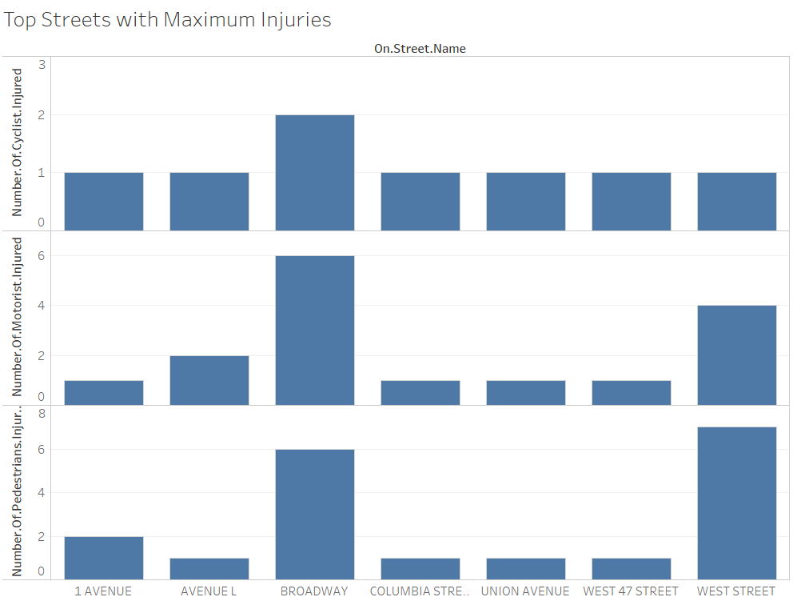
TOP STREETS WITH MOST INJURIES
MANHATTAN:
1 Avenue:
Broadway
West 47 street
West street
BROOKLYN:
Avenue L
Columbia Street
Union Avenue
Notes:
Analysis over 1 million data shows an constant trend in collision over the years in New York

Slide 17
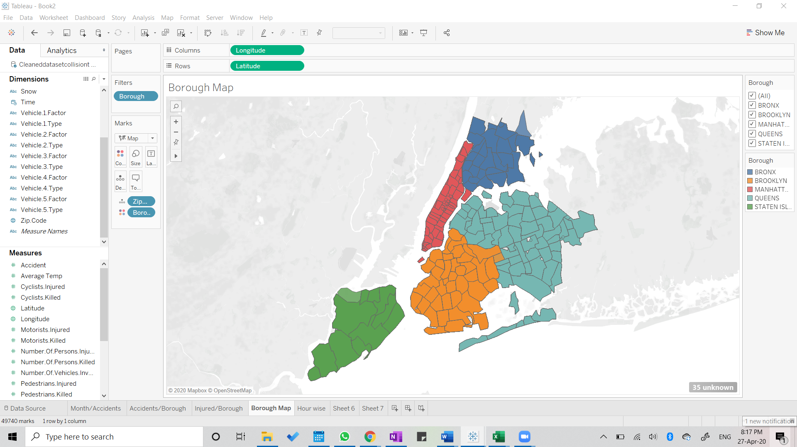
TOP STREETS WITH MOST INJURIES
LARGEST BOROUGH: QUEENS
SMALLEST BOROUGH: MANHATTAN
Small borough with cluttered streets could be cause of more injuries on Manhattan streets
Notes:
Analysis over 1 million data shows an constant trend in collision over the years in New York

Slide 18
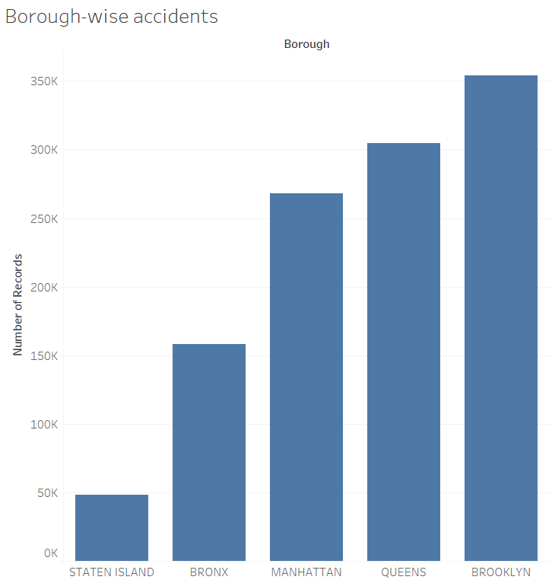
BOROUGH WITH MOST COLLISIONS
Borough: Brooklyn
No of records: 354,136
Notes:
Analysis over 1 million data shows an constant trend in collision over the years in New York

Slide 19
DASHBOARDS
https://public.tableau.com/profile/kaumudi.kulkarni#!/vizhome/Book3-KAUMUDI/Dashboard1
https://public.tableau.com/profile/archana.mahapatra#!/vizhome/VehicleCollisionsStatistics/Dashboard3
https://public.tableau.com/profile/archana.mahapatra#!/vizhome/Madhvika_BI_DashboardNew/StreetIntersectionandFactors

Slide 20
INFERENCE FROM DASHBOARD
TOP COLLISION INTERSECTIONS:
BRONX
BROOKLYN
MANHATTAN
QUEENS
STATEN ISLAND
JEROME AVENUE
EAST TREMONT AVENUE
3RD AVENUE
4TH AVENUE
FLATBUSH AVENUE
BROADWAY
CANAL STREET
JAMAICA AVENUE
HILLSIDE AVENUE
BEDFORD AVENUE
HYLAN BOLEVARD
ATLANTIC AVENUE
FULTON STREET

Slide 21
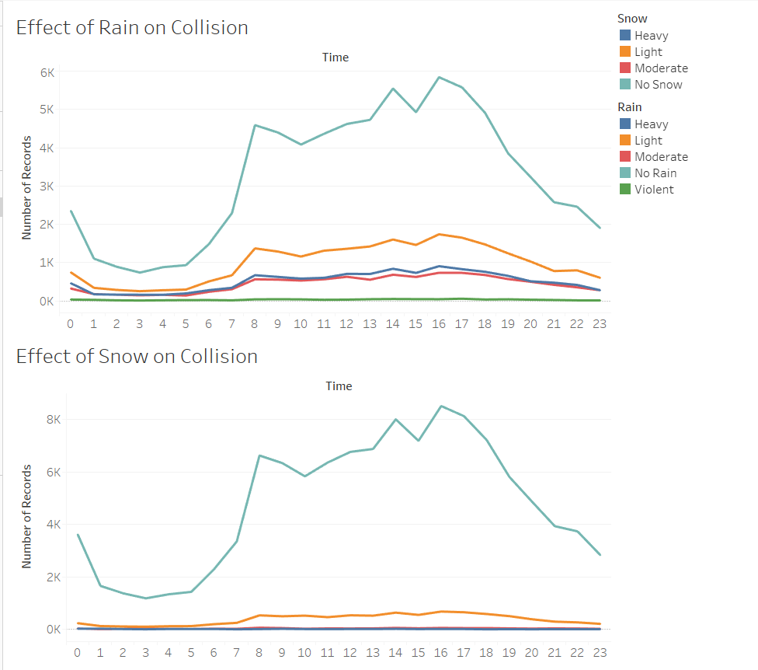
CASE STUDY: EFFECT OF WEATHER
Weather has no significant effect over collisions taking place

Slide 22
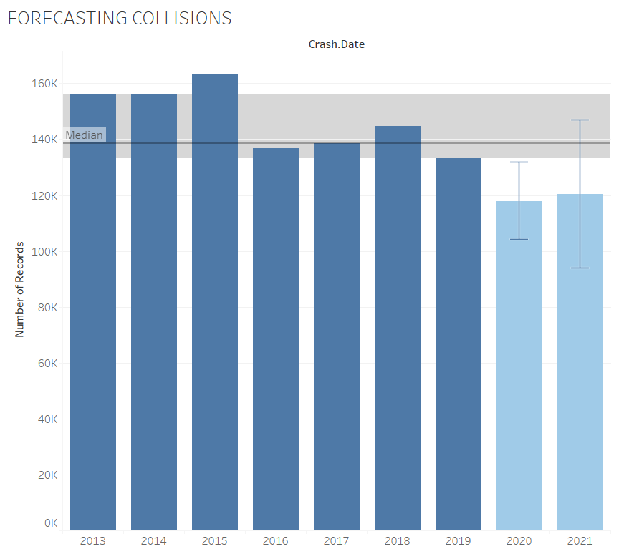
FORECASTS
Vision Zero by 2024
Median = 138,520
Lower Quartile=133,085
Upper Quartile=155,974
Estimate 2020: 117,880
Estimate 2021: 120,508
Notes:
Program started by mayor, reduce by 2024…but the forecast does not reflect that, even though there has been a reduce but not so much that it gets 0

Slide 23
MAKE RESIDENTS AWARE OF DANGEROUS INTERSECTIONS
INCREASE MORE PATROLLING DURING PEAK HOURS
SUMMARY
BE CAUTIOUS OF CYCLISTS IN SUMMERS AND PEDESTRIANS IN WINTERS

Slide 24
Make predictions of collisions using subsets of data (feature selection)
NEXT STEPS
Implement feedback from presentation

Slide 25
THANK YOU!
QUESTIONS?

Slide 26
CITATIONS
(NYPD), P. D. (2020, April 27). Motor Vehicle Collisions - Crashes: Open Data NY. Retrieved from https://data.ny.gov/Public-Safety/Motor-Vehicle-Collisions-Crashes/h9gi-nx95
“Traffic Collisions.” NYC Collision Data Insights, people.ischool.berkeley.edu/~ellyrath/data.html.
“April Is a Slow Month for NY Auto Accidents-But It Won't Last.” Rosenblum Law, traffictickets.com/data/april-is-a-slow-month-for-ny-auto-accidents-but-it-wont-last/.
“Location in New York.” New York Personal Injury Lawyers, 9 Oct. 2019, www.dandalaw.com/2019/06/05/are-car-accidents-common-in-new-york-city/.

